Slide 1
Remote Access
Work from any location into your office PC

Slide 2
Before you Start…
Email computing@eas.gatech.edu, so your firewall can be properly set up in order to allow your connection.
Download SecureCRT from here and install it on your computer.

Slide 3
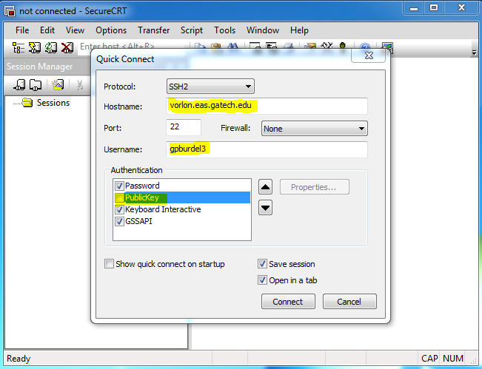
Set up the connection…
The first time you open the program, you’ll see this screen. Enter the hostname as vorlon.eas.gatech.edu and your GT username.
Uncheck PublicKey.
Click on

Slide 4
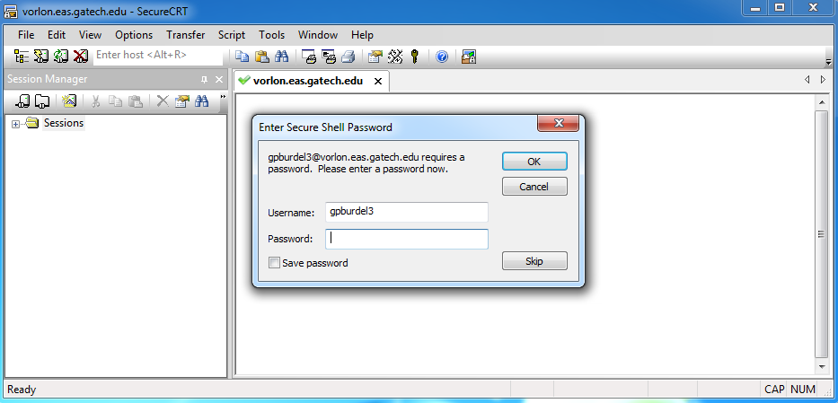
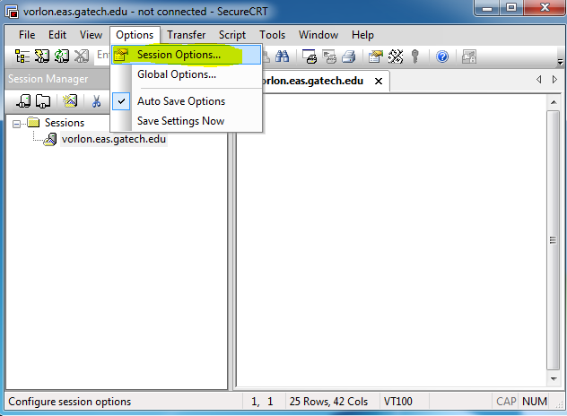
You’ll be prompted for you password. Click on
Click on the options menu
Select Session Options

Slide 5
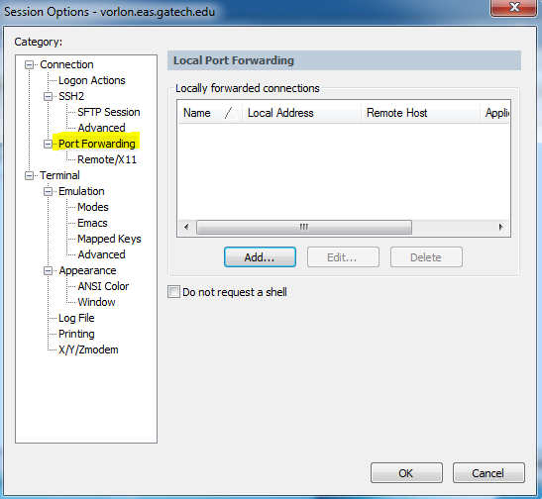
At this window, click on Port Forwarding and then click on

Slide 6
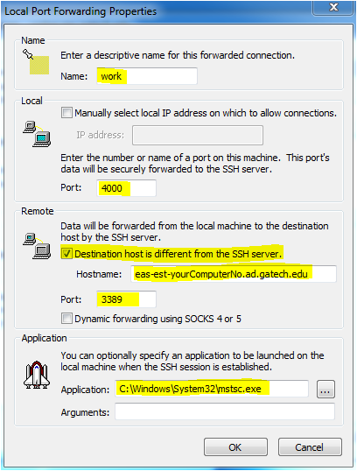
Forwarding Properties
Assign a name for your connection.
Enter the local port of your computer to communicate using SSH as 4000 .
Check mark Destination host is different from SSH server, enter the name of your computer in the hostname space, and the port for remote connection as 3389 .
Fill out the application path with: C:\WINDOWS\System32\mstsc.exe
Click on twice to close and save your settings.

Slide 7
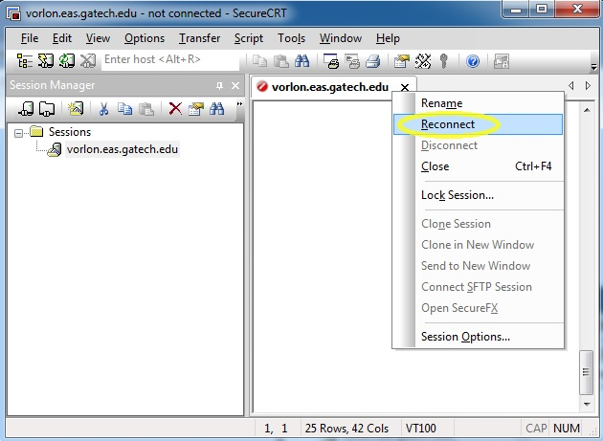
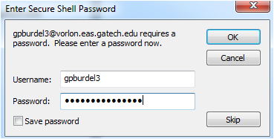
Then, do a right click over your connection, so it will display the session properties menu.
Then select Reconnect (circled on yellow). You’ll be prompted for your password. Enter it and click

Slide 8
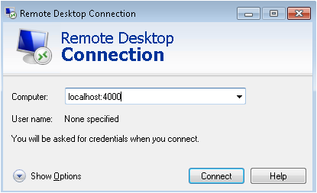
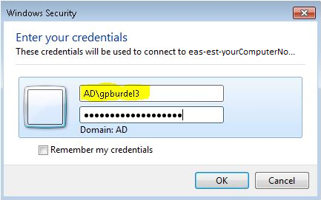
The Remote Desktop Connection window will appear. Enter localhost:4000 in the Computer.
The log on screen for your office computer will appear. Log on as if you were sitting right in front of it.
You can start working now!

